Slide 1




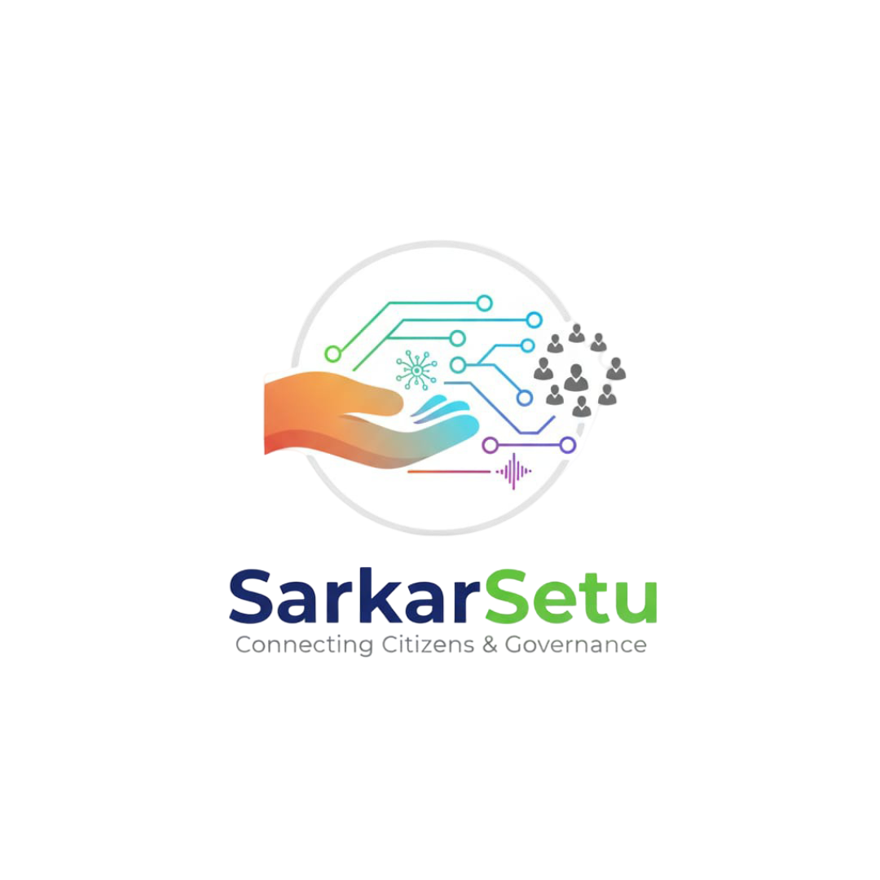
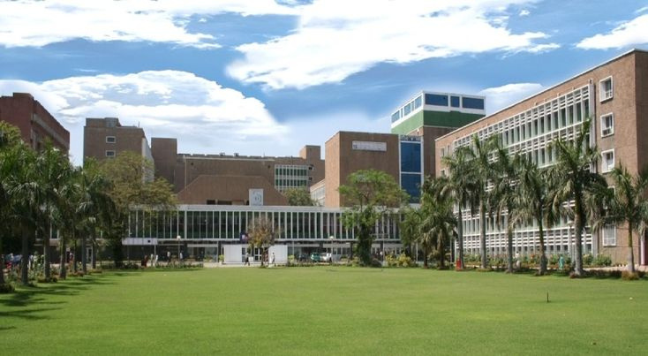
SarkarSetu :- Never Miss an Opportunity
Civic Technology & Governance
1

Slide 2

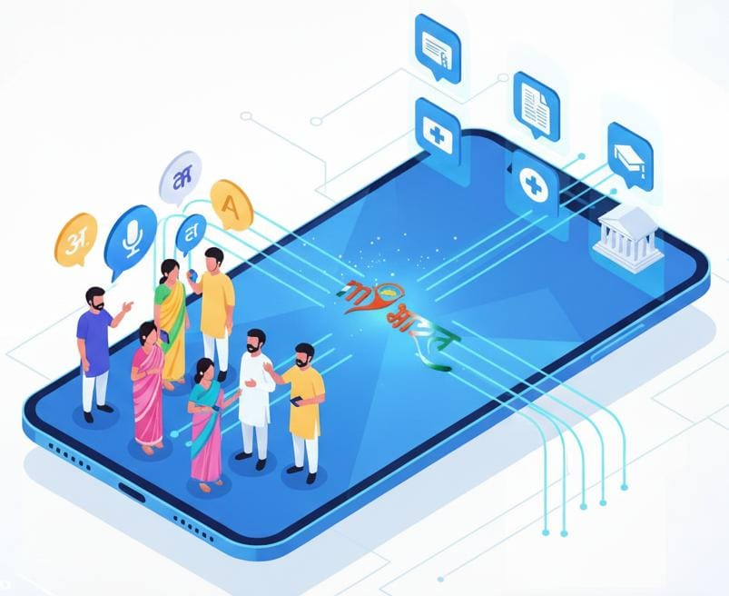
Introduction
Connecting Every Citizen to the Right Government Scheme – Instinctively, Instantly
Our platform focuses on:
Personalized Scheme Delivery
AI-Driven matching to instantly find schemes based on user profile.
Vernacular Voice & Text Assistance
Ask in any language – the understands and guides clearly.
Eligibility Check & Ranking
Smart scoring engine that ranks the most suitable schemes.
Simplified Application Guidance
Easy steps, required documents, and direct links to apply fast.
Empowering every citizen with clarity, access and confidence.
2

Slide 3
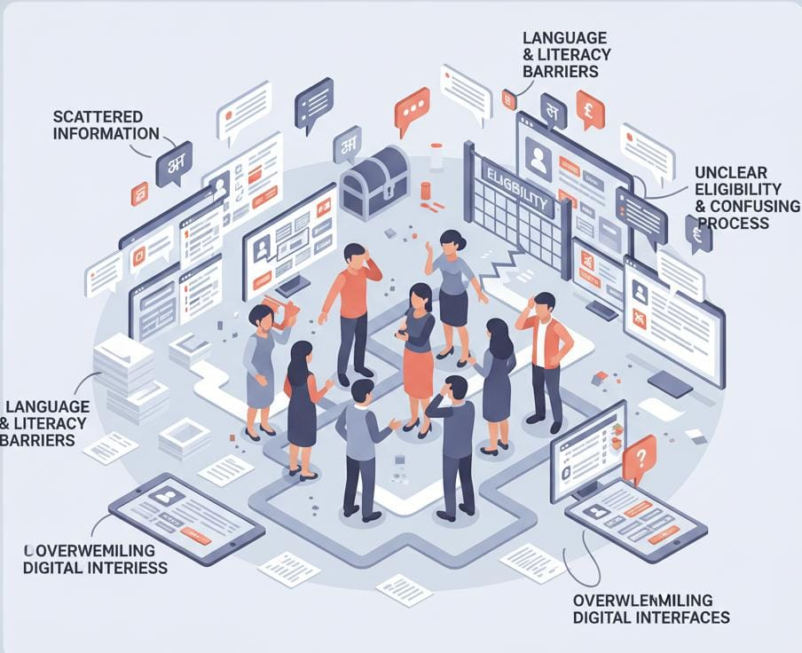
Problem Statement
Scattered Information
Government schemes are spread across multiple portals, formats, and departments, making it difficult for citizens to find accurate and updated details.
Language and Literacy Barriers
Many users struggle to understand scheme details due to complex terminology and lack of support in regional languages.
Unclear Eligibility & Confusing Process
Citizens often do not know which schemes they qualify for, what documents are required, or how to apply – leading to missed opportunities.
Overwhelming Digital Interfaces
Existing portals are difficult to navigate, especially for non-tech savvy users, causing frustration and low adoption.
3

Slide 4
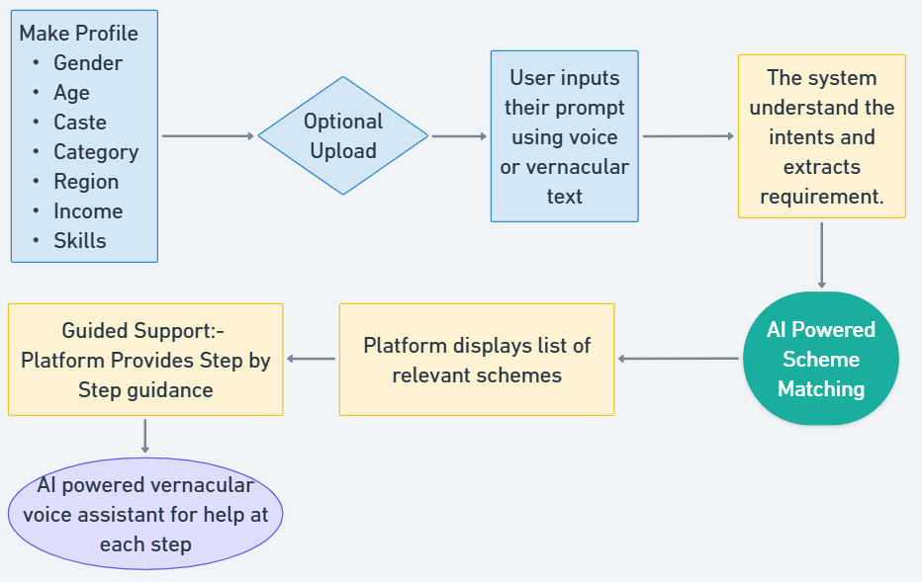
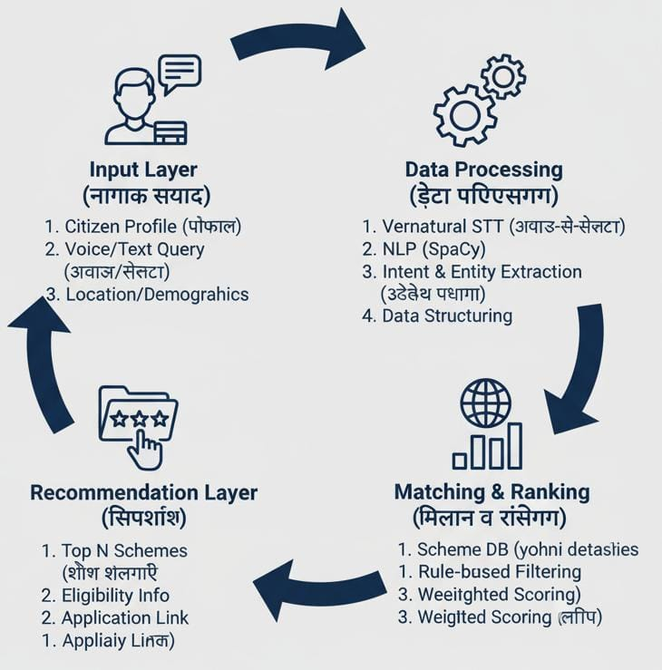
FLOW - DIAGRAM
3

Slide 5
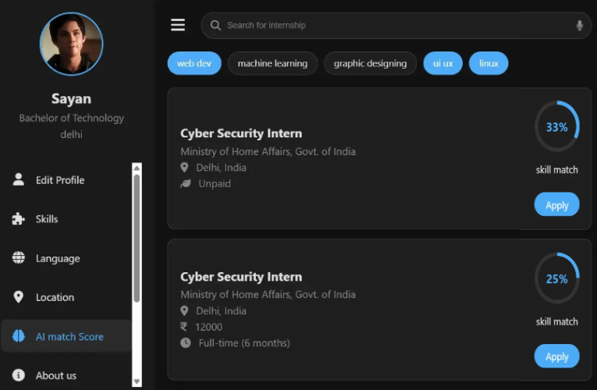
Model Explanation
Our app uses a simple, step-by-step AI-powered workflow to help users understand their health needs:
User Profile Setup
User Select language and enter basic details to build their profile
Query & Intent Capture
User ask their need (text/voice) & the system understands the intent
AI Powered Scheme Matching
The model analyses profile with schemes and ranks the best matches
Guided Application Support
  Step-by-step instructions for filling the application
  List of required documents with format & size guidelines.
  Important dates such as deadlines and verification timings.
  Nearest office locations with work hours and contact details.
  Vernacular voice guidance to help users complete every step smoothly.
5
Notes:
.

Slide 6
CONCLUSION
Our app uses a simple, step-by-step AI-powered workflow to help users understand relevant schemes for them:
Elderly people with less tech exposer.
Young Students with professional background
Rural women & farmers get benefits
Economically weaker section gets updates on relevant schemes.
References:
Open Government Data Platform India (OGD)- https://data.gov.in
MyScheme –for browsing, filtering, and checking eligibility https://www.myscheme.gov.in
Google Research – Speech & Language Team Research on speech-to-text, multilingual NLP, and voice-based interaction models relevant to vernacular voice search. https://research.google/teams/language
Whimsical – Flowchart & Diagram Tool for the project. https://whimsical.com
LLaMA 3.1 – Large Language Model Reference architecture for the AI/LLM component used in scheme matching and Q&A. https://ai.meta.com/llama
Thankyou.
5
Notes:
.

